Slide 1
Unpacking the SNA Teaching, Learning & Technology Framework: Specials
August 2016
Marie Himes
mphimes@ncsu.edu

Slide 2
Session Objectives
Develop understanding of the purpose and functions of curriculum maps
Become familiar with the structure of SNA’s Teaching, Learning and Technology Framework
Identify curricular connections in support of horizontal, vertical, and interdisciplinary alignment within and across instruction and learning at SNA

Slide 3
Guiding Question 1:
How are curriculum maps (pacing guides) organized for your content area?

Slide 4
SNA Teaching, Learning & Technology Framework:
Elective Course Offerings (Specials) Recommendations
Technology and Computer Science
AP Computer Science A
Web Design
Robotics
English and Communications
Public Speaking
Creative Writing
Science
Forensic Science
Engineering Design
History and Social Studies
Global Issues
Fine and Performing Arts
Video Production
Business and Finance
Introduction to Entrepreneurship

Slide 5
SNA Teaching, Learning & Technology Framework:
Specials Pacing Guide Structures
Modules
Units
Essential Questions (ELA)
Standards
Learning Objectives
Time
Additional items to consider adding:
Terminology
Texts & Resources

Slide 6
Recommended Standards for Specials
National Core Arts Standards:
Theater
Visual Arts
Dance
Media Arts
Music
Music - Harmonizing Instruments
Music - Composition and Theory
Music - Traditional and Emerging Ensembles
Music – Technology
Society of Health and Physical Educators (SHAPE) America:
Physical Education
North Carolina Essential Standards:
Theater
Visual Arts
Dance
Music
Physical Education
Health Education
Chinese Standards for High School

Slide 7
Guiding Question 1:
How are curriculum maps (pacing guides) organized for your content area?
Do you have any questions about the structure of your content area’s curriculum maps (pacing guides)?

Slide 8
Guiding Question 2:
How do the curriculum maps (pacing guides) inform instruction?

Slide 9
Curriculum Maps Instruction
Module
Standards-based Assessments
Standards-based Assessments
Unit 1
Unit 2
Standards-based Assessments
Lesson A
Lesson B
Lesson C
Lesson D
Lesson E
Lesson F
Standards-based Assessments
Standards-based Assessments
Standards-based Assessments
Standards-based Assessments
Standards-based Assessments
Standards-based Assessments
Standards-based Instruction
Standards-based Instruction
Standards-based Instruction
Standards-based Instruction
Standards-based Instruction
Standards-based Instruction

Slide 10
Guiding Question 2:
How do the curriculum maps (pacing guides) inform instruction?
Do you have any questions about how to use the curriculum maps (pacing guides) when writing your instructional plans?

Slide 11
Guiding Question 3:
How do the curriculum maps (pacing guides) support vertical coherence?

Slide 12
Vertical Coherence In Curriculum Maps
Visual Arts I Pacing Guide
Module A: Elements of Art and Principles of Design in Eastern and Western Cultures
Essential Question: How is art influenced by the development of a civilization?
Module B: Art and Society
Essential Question: In what ways do political and social issues affect artistic expression?
Module C: Social Change and Art
Essential Question: How does art reflect cultural change?
Visual Arts II Pacing Guide
Module A: The Aesthetic Value of Art
Essential Question: What factors may inspire an artist?
Module B: The Communicative Properties of Art
Essential Question: In what ways do the elements of art and principles of design affect communication of an idea?
Module C: Art Appreciation and Critique
Essential Question: What criteria can be used to critique art?

Slide 13
Guiding Question 4:
How do the curriculum maps (pacing guides) support horizontal coherence?

Slide 14
Horizontal Coherence In Curriculum Maps
Curriculum maps provide the foundation for…
Co-creating Pacing Guides
Co-planning Instruction
Common Assessments
Collaboratively Analyzing Student Data
Where are these things carried out?
In your Professional Learning Teams (PLTs)!

Slide 15
Guiding Question 5:
How do the curriculum maps (pacing guides) support interdisciplinary coherence?

Slide 16
Interdisciplinary Coherence In Curriculum Maps
Physical Education Pacing Guide
Module A: Movement Skills
Essential Question: What skills are essential to support effective participation in physical activity?
Module B: Sportsmanship, Rules, and Safety
Essential Question: In what ways do athletic endeavors impact lifelong decisions and activities?
Module C: Strategies for Individual and Team Excellence
Essential Question: What qualities define a good team player?
Module D: Lifelong Fitness
Essential Question: How does physical activity benefit the quality of life?
Visual Arts I Pacing Guide
Module A: Elements of Art and Principles of Design in Eastern and Western Cultures
Essential Question: How is art influenced by the development of a civilization?
Module B: Art and Society
Essential Question: In what ways do political and social issues affect artistic expression?
Module C: Social Change and Art
Essential Question: How does art reflect cultural change?

Slide 17
Guiding Questions 3, 4, & 5:
How do the curriculum maps (pacing guides) support vertical, horizontal, and interdisciplinary coherence?
Do you have any questions on vertical, horizontal, and interdisciplinary alignment within and across curriculum maps (pacing guides)?

Slide 18
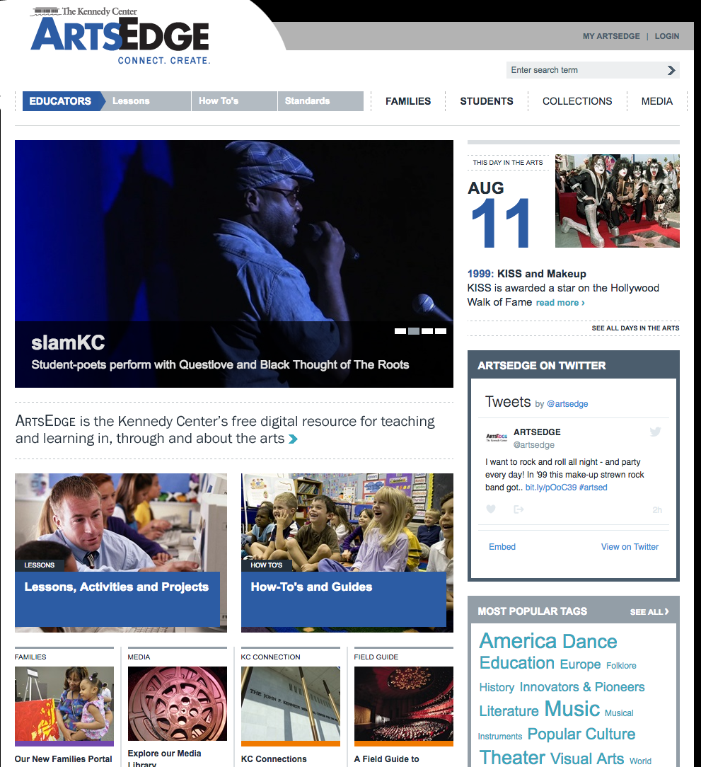
Digital Resources for the Fine Arts: ArtsEdge
From http://artsedge.kennedy-center.org/educators.aspx

Slide 19
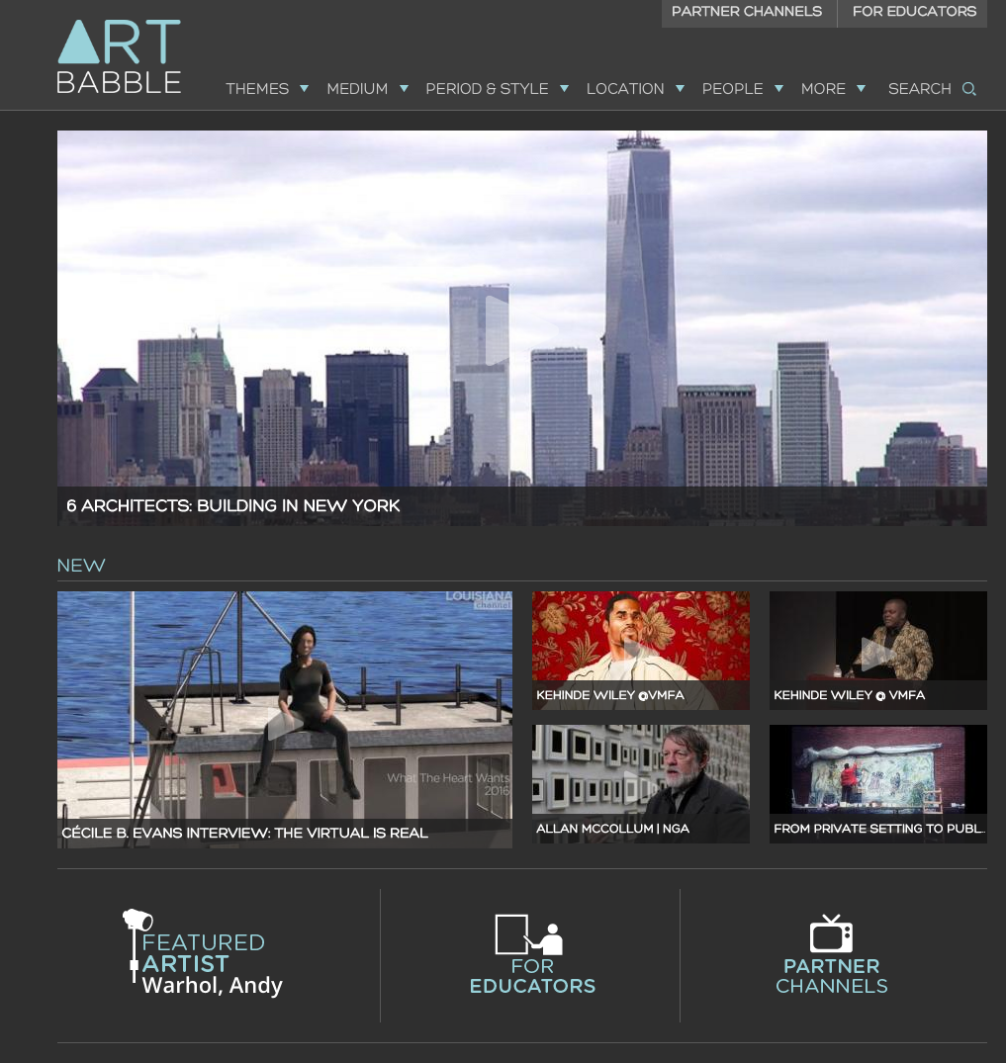
Digital Resource for Visual Art: ART Babble
From http://www.artbabble.org/

Slide 20
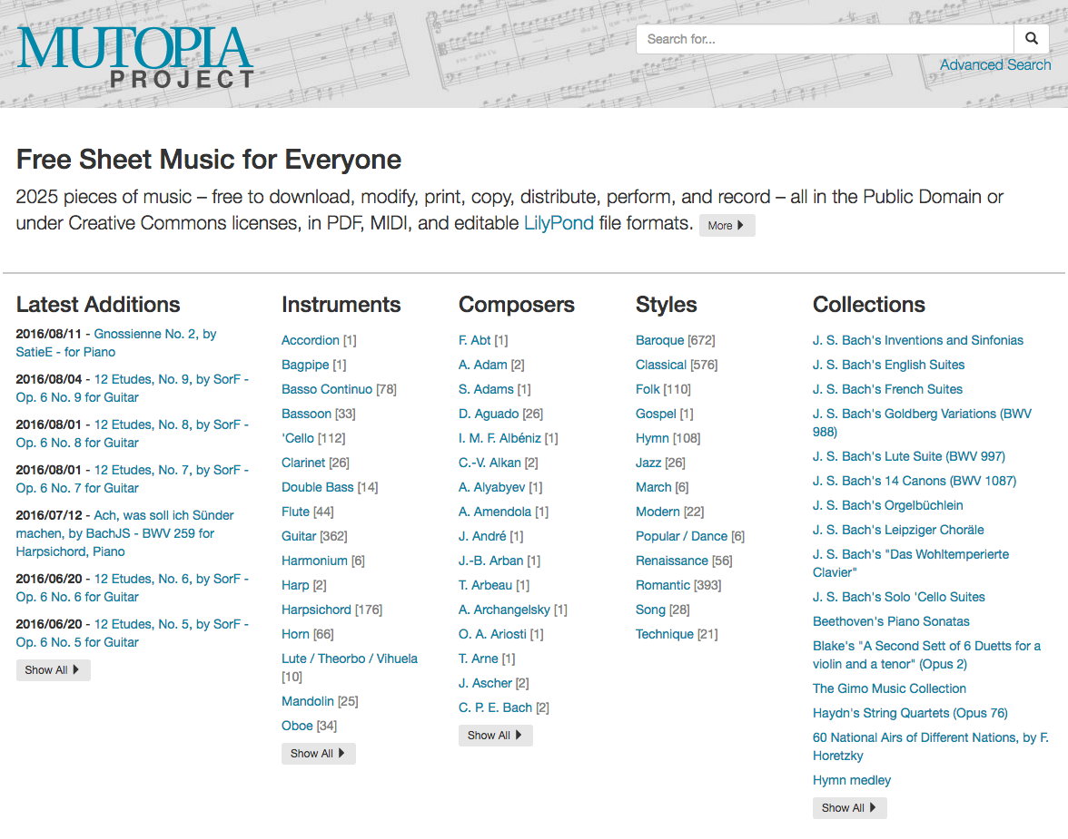
Digital Resources for Music: Mutopia
From http://www.mutopiaproject.org/
Web 2.0 Tools for Music Teachers: http://watsonmusic.wikispaces.com/LISTS+of+WEB+2.0+RESOURCES+for+MUSIC+TEACHERS

Slide 21
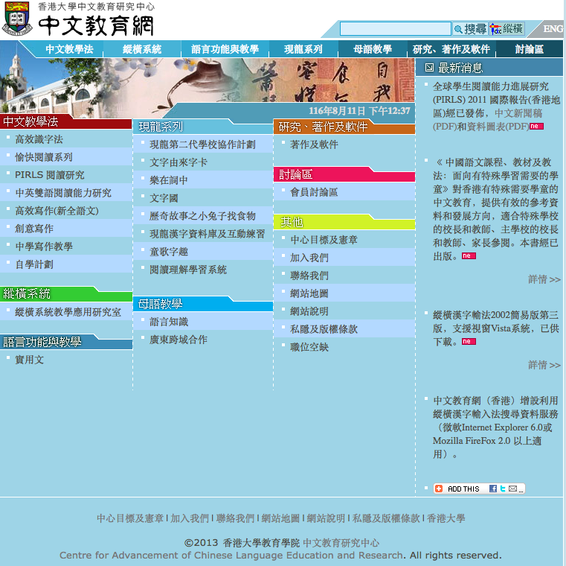
Digital Resources for Chinese: Center for Advancement of Chinese Language Education and Research
From http://www.chineseedu.hku.hk/index.htm

Slide 22
Digital Resources for Physical Education: PE Central
From http://www.pecentral.org/

