Slide 1
Unpacking the SNA Teaching, Learning & Technology Framework: The Sciences
August 2016
Marie Himes
mphimes@ncsu.edu

Slide 2
Session Objectives
Develop understanding of the purpose and functions of curriculum maps
Become familiar with the structure of SNA’s Teaching, Learning and Technology Framework
Identify curricular connections in support of horizontal, vertical, and interdisciplinary alignment within and across instruction and learning at SNA

Slide 3
Guiding Question 1:
How are curriculum maps organized for your content area?

Slide 4
SNA Teaching, Learning & Technology Framework:
Science Course Offerings
Science Curriculum Maps
Chemistry
Biology
Physics
AP Course Options
AP Biology
AP Chemistry
AP Physics C: Mechanics
AP Physics C: Electricity and Magnetism
AP Physics 1: Algebra-based
AP Physics 2: Algebra-based

Slide 5
SNA Teaching, Learning & Technology Framework:
Science Curriculum Map Structures
Modules
Overview/Description
Essential Questions (ELA)
Standards
Learning Objectives
Terminology
Texts & Resources
Sample Activities & Assessments
Sample Lesson Plan

Slide 6
Recommended Science Course Sequences
Sequences | Grade 10 | Grade 11 | Grade 12
1 | Chemistry | Biology | Physics
2 | Chemistry | Biology | AP Chemistry
3 | Chemistry | Biology | AP Biology
4 | Chemistry | AP Chemistry | Biology
5 | Chemistry | Physics | AP Physics 2: Algebra-based*
6 | Chemistry | AP Chemistry | AP Physics 1: Algebra-based
7 | Chemistry | AP Physics 1: Algebra-based | AP Chemistry
8 | Chemistry | AP Physics 1: Algebra-based | AP Physics 2: Algebra-based
9 | Chemistry | Physics | AP Physics C: Mechanics**
10 | Chemistry | AP Physics 1: Algebra-based | AP Physics C: Mechanics**
*must be taking or have taken precalculus **must be taking or have taken calculus

Slide 7
Recommended Accelerated Science Course Sequences
SEQUENCES | GRADE 10 | GRADE 11 | GRADE 12
1 | Chemistry and Biology | AP Chemistry | AP Biology
2 | Chemistry and Biology | AP Chemistry and AP Biology | Physics or AP Physics 1: Algebra-based
3 | Chemistry and Biology | AP Chemistry and Physics or AP Physics 1: Algebra-based | AP Physics 2: Algebra-based* and AP Biology
4 | Chemistry and Biology | AP Chemistry and Physics or AP Physics 1: Algebra-based | AP Physics C: Mechanics** and AP Biology
5 | Chemistry and Physics or AP Physics 1: Algebra-based | AP Chemistry and AP Physics C: Mechanics** | AP Physics C: Electricity and Magnetism** and Biology
6 | Chemistry and Physics or AP Physics 1: Algebra-based | Biology and AP Physics 2: Algebra-based* | AP Chemistry and AP Biology
7 | Chemistry and Physics or AP Physics 1: Algebra-based | Biology and AP Physics C: Mechanics** | AP Physics C: Electricity and Magnetism** and AP Biology or AP Chemistry
*must be taking or have taken precalculus **must be taking or have taken calculus

Slide 8
Guiding Question 1:
How are curriculum maps organized for your content area?
Do you have any questions about the structure of your content area’s curriculum maps?

Slide 9
Guiding Question 2:
How do the curriculum maps inform instruction?

Slide 10
Curriculum Maps Instruction
Module
Standards-based Assessments
Standards-based Assessments
Unit 1
Unit 2
Standards-based Assessments
Lesson A
Lesson B
Lesson C
Lesson D
Lesson E
Lesson F
Standards-based Assessments
Standards-based Assessments
Standards-based Assessments
Standards-based Assessments
Standards-based Assessments
Standards-based Assessments
Standards-based Instruction
Standards-based Instruction
Standards-based Instruction
Standards-based Instruction
Standards-based Instruction
Standards-based Instruction

Slide 11
Guiding Question 2:
How do the curriculum maps inform instruction?
Do you have any questions about how to use the curriculum maps when writing your instructional plans?

Slide 12
Guiding Question 3:
How do the curriculum maps support vertical coherence?

Slide 13
Vertical Coherence In Curriculum Maps
Chemistry Curriculum Map
Module A: Energy as a Driving Force
Module G: Chemical Reactions and Stoichiometry
North Carolina Essential Standards Chemistry
Chm.2.1 Understand the relationship among pressure, temperature, volume, and phase.
Chm.2.2 Analyze chemical reactions in terms of quantities, product formation, and energy.
Essential Questions: How do changes in the kinetic energy of a system affect the system? How can you calculate the amount of energy needed to change phase given set parameters? How can I tell that a chemical reaction has taken place?
Biology Curriculum Map
Module D: Matter and Energy in Organisms (Cellular Energy)
Module E: Matter and Energy in Ecosystems
North Carolina Essential Standards Biology
Bio.4.2 Analyze the relationships between biochemical processes and energy use in the cell.
Essential Questions: How can an organism maintain homeostasis? What is diffusion and how does it enable the cell to move materials into and out of the cell? How does an organism maintain homeostasis? How does a plant produce energy? How do plants turn sunlight into sugar?

Slide 14
Guiding Question 4:
How do the curriculum maps support horizontal coherence?

Slide 15
Horizontal Coherence In Curriculum Maps
Curriculum maps provide the foundation for…
Co-creating Pacing Guides
Co-planning Instruction
Common Assessments
Collaboratively Analyzing Student Data
Where are these things carried out?
In your Professional Learning Teams (PLTs)!

Slide 16
Guiding Question 5:
How do the curriculum maps support interdisciplinary coherence?

Slide 17
Interdisciplinary Coherence In Curriculum Maps
Physics Curriculum Map
Module A: One Dimensional Motion
NC Essential Standards for Physics
Phy.1.1 Analyze the motion of objects.
Phy1.1.1 Analyze motion graphically and numerically using vectors, graphs, and calculations.
Phy.1.1.2 Analyze motion in one dimension using time, distance, displacement, velocity, and acceleration.
Precalculus Curriculum Map
Module C: The Individual and Society (Nonfiction Emphasis)
Common Core State Standards (CCSS) for Mathematics
CCSS.MATH.CONTENT.HSF.IF.A.2: Use function notation, evaluate functions for inputs in their domains, and interpret statements that use function notation in terms of a context.
CCSS.MATH.CONTENT.HSF.IF.B.4: For a function that models a relationship between two quantities, interpret key features of graphs and tables in terms of the quantities, and sketch graphs showing key features given a verbal description of the relationship.
Similar Key Terminology
Distance
Linear/Linear Motion/Linear Function
Constant/Constant Function/Constant Acceleration/Constant Velocity

Slide 18
Guiding Questions 3, 4, & 5:
How do the curriculum maps support vertical, horizontal, and interdisciplinary coherence?
Do you have any questions on vertical, horizontal, and interdisciplinary alignment within and across curriculum maps?

Slide 19
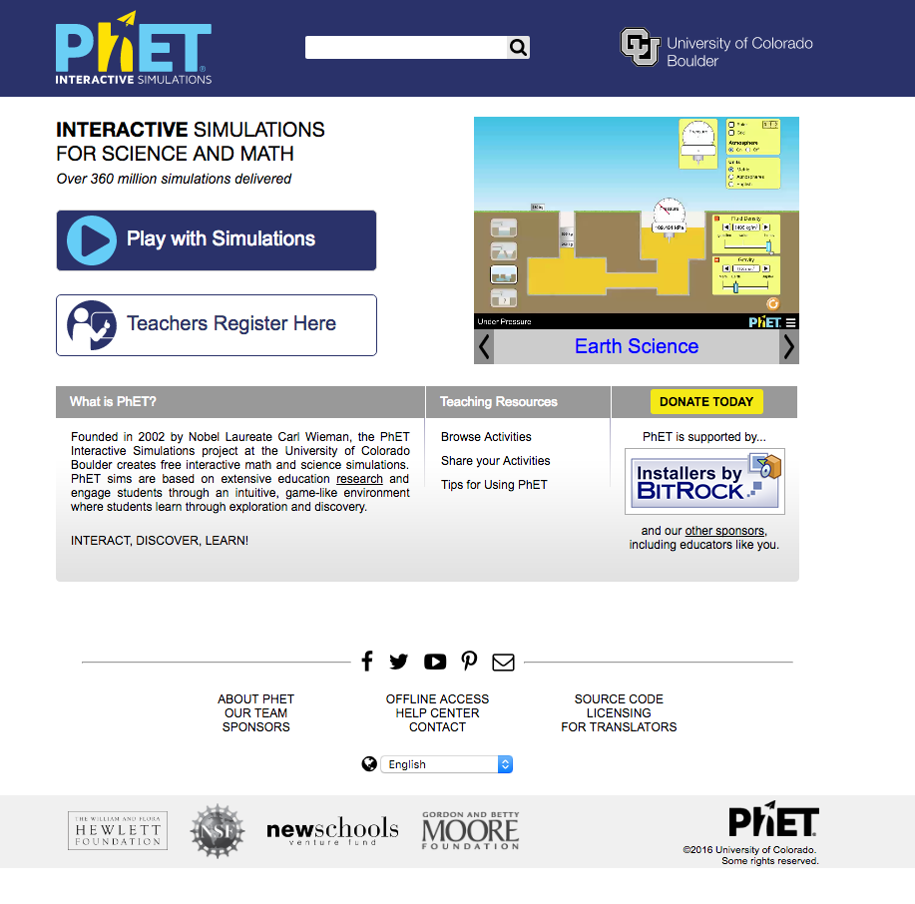
Digital Resources for Science: PhET
From https://phet.colorado.edu/

Slide 20
Digital Resources for Science: Teach Engineering
From https://www.teachengineering.org/

Slide 21
Digital Resources for Science: cK-12
From http://www.ck12.org/

Slide 22
Digital Resources for Science: SAS Curriculum Pathways
From https://www.sascurriculumpathways.com/portal/

Slide 23
Digital Resources for Science: BioInteractive
From http://www.hhmi.org/biointeractive

